Slide 1



SearchIBM
Search on IBM
History
Favorites
Progress

Slide 2
SearchIBM
Transferring information on the network
Transferring information on the global network
Transferring information on the local network
Transferring information to new phone

Slide 3
Search result - Cataloging
ss
What is private cloud
Results:
What is private cloud?
Unfavorite
Cloud Private Hosted
Favorite
Deploying Cloud Private on private clouds
Favorite

Slide 4
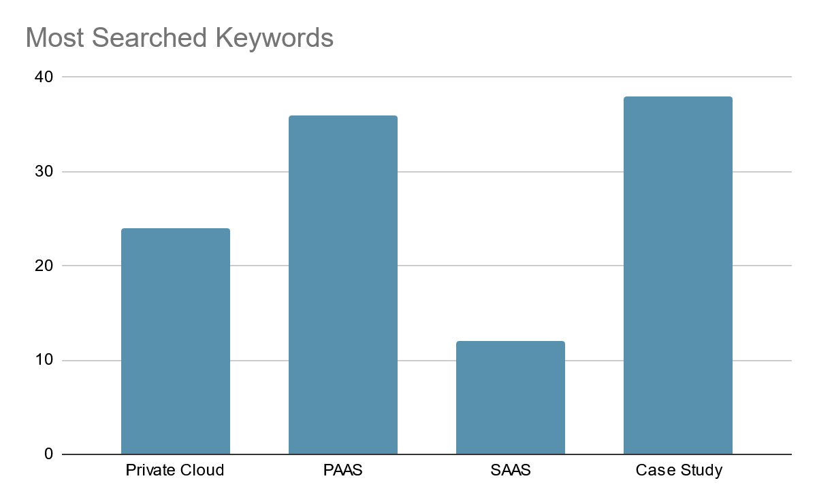
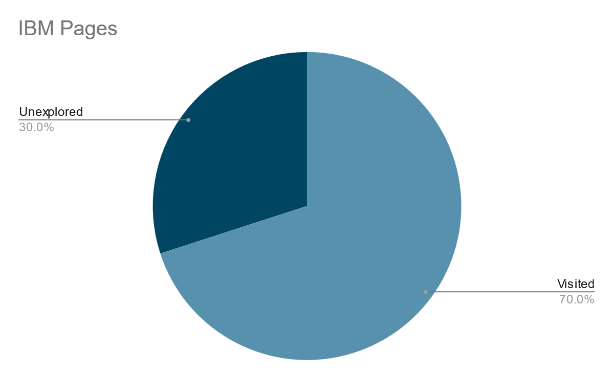
Your Progress
ss

